Slide 1
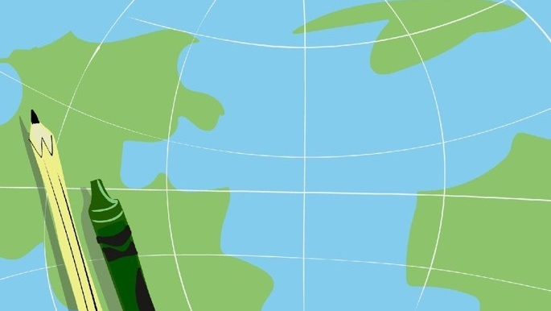
2021 U.S. Children’s Map Competition
Dierdre Bevington-Attardi, Competition Coordinator
Aileen Buckley, Chair - U.S. National Committee for the International Cartographic Association (ICA)

Slide 2
Link from https://cartogis.org/awards/children/

Slide 3
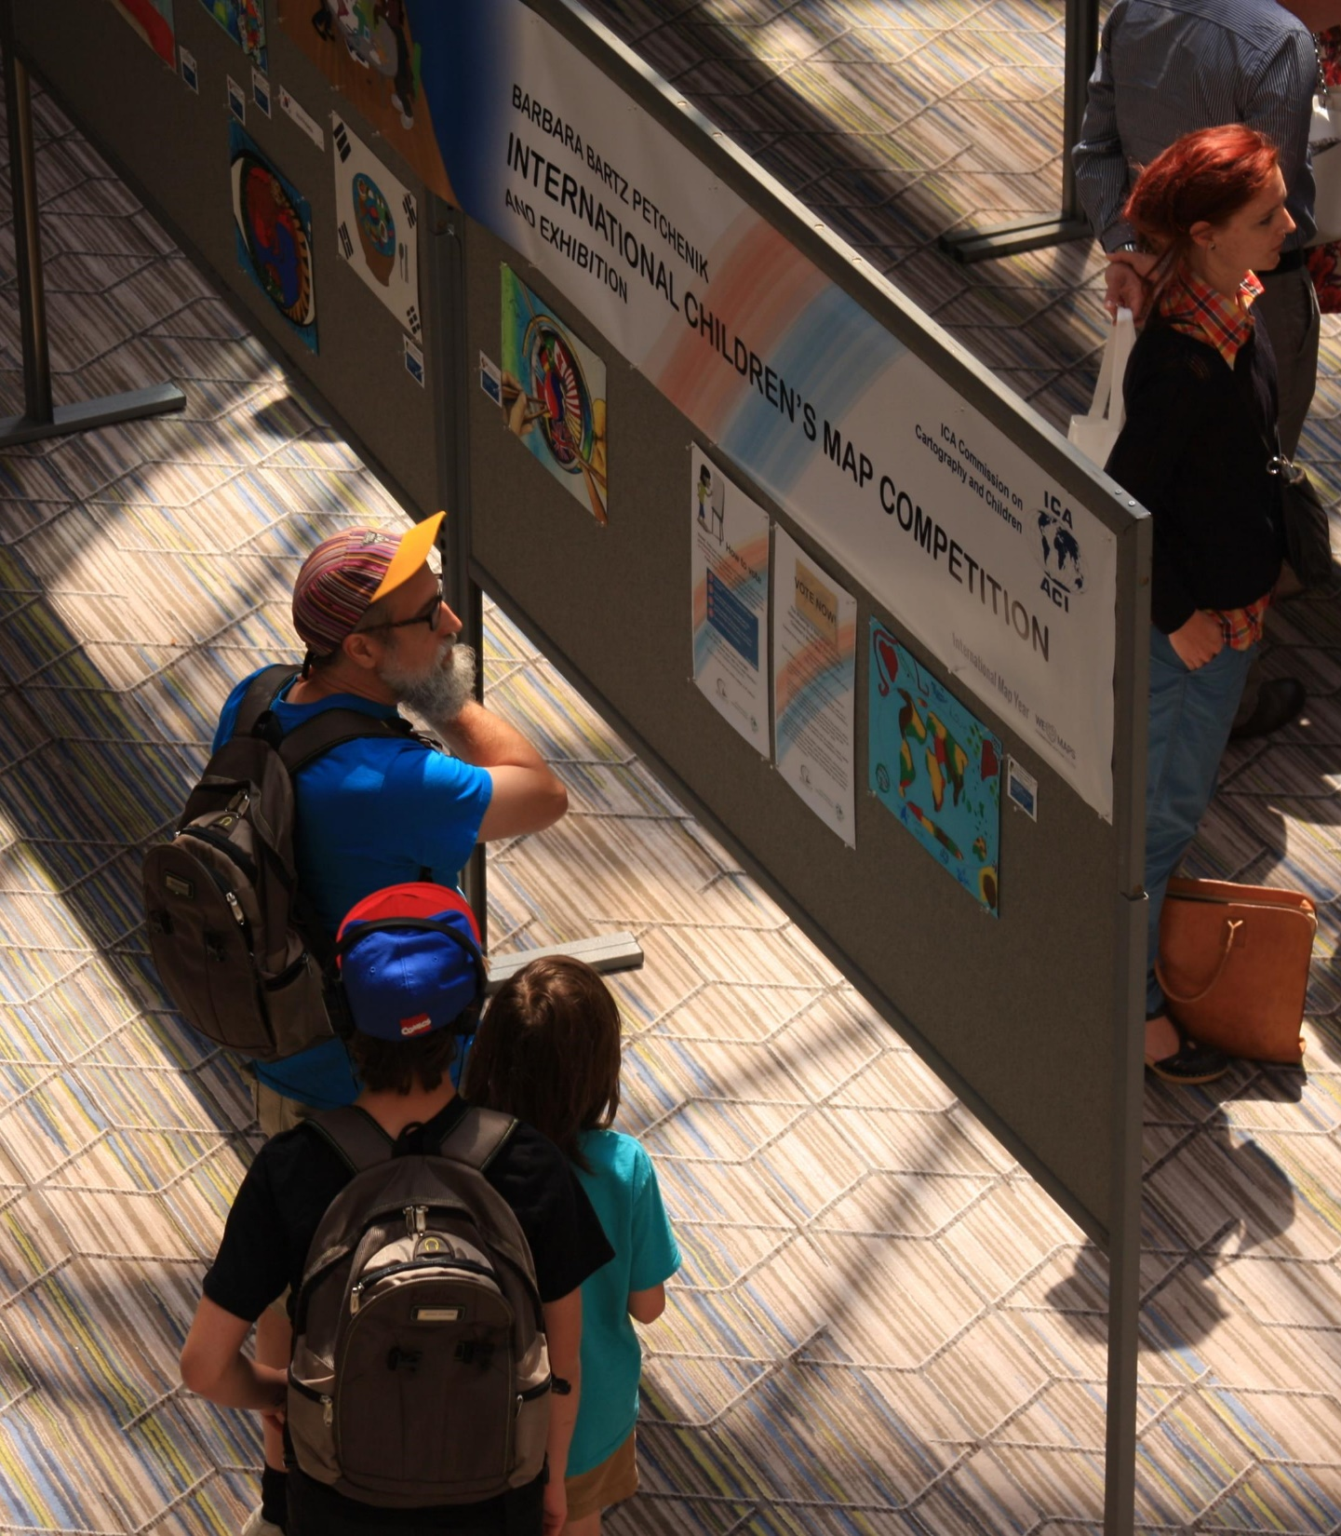
Children’s Map Competitions
Every two years, six finalists from each International Cartographic Association (ICA) member country’s children’s map competitions are chosen for the international Barbara Petchenik Children’s Map Competition which is hosted during the biennial International Cartographic Conference (ICC). The next ICC is being held in Florence, Italy (hybrid format) in Dec. 2021.
The U.S. Children’s Map Competition is judged by members of the U.S. National Committee (USNC) for the ICA prior to the ICC. Six finalists are chosen from the 1st, 2nd, and 3rd place winners in each age category and sent to the ICC to be entered in the international Petchenik competition.

Slide 4
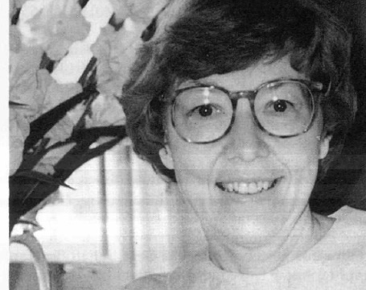
Barbara Bartz Petchenik believed in the power of maps to communicate a “larger, meaningful, reality.”
The aims of contest named in her honor are to promote children’s creative represent-tation of the world, to enhance their cartographic awareness and to make them more conscious of their environment.

Slide 5
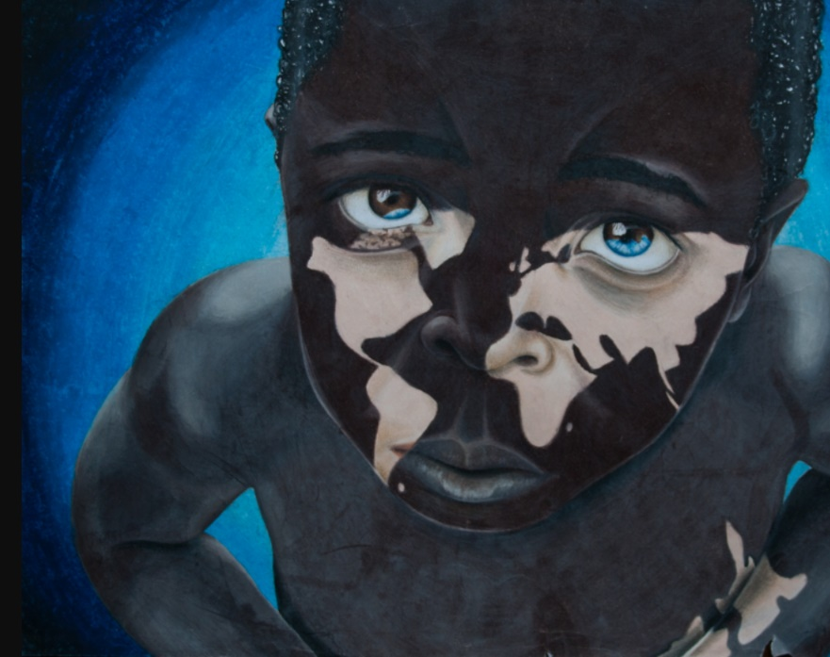
The Children’s Map Competition is a rare opportunity for kids to tell their story about the world through maps, with meaning.
Rebecca Kneale & Akira McTavish-Huriwai (age 15), Through a Child’s Eyes, Finalist from New Zealand, 2017.
Notes:
Now, 26 years after the establishment of the Petchenik Children's World Map Drawing Competition, kids have an almost rare opportunity to create a map by hand—with nothing more than a simple quest for meaning and with what today's cartographers would consider rudimentary instruments. We are the recipients of her remarkable cartographic legacy and the stewards of her mission to create meaningful cartography with every map produced for this competition.
Children's

Slide 6
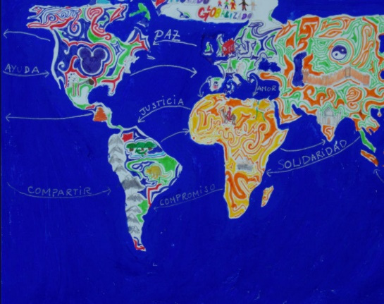
Students are encouraged to develop a theme and focus their observations on “content and ideas.”
Alberto Duran Ortiz (age 12), All Together. Finalist from Spain, 2009.

Slide 7
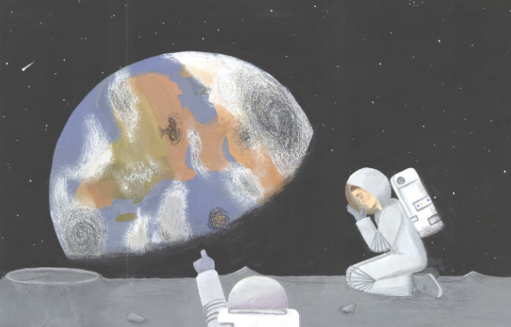
This Year’s Theme:
“A Map of My Future World”
Anne Berg (Age 15). If We Don’t Change. Finalist from United States, 2019.

Slide 8
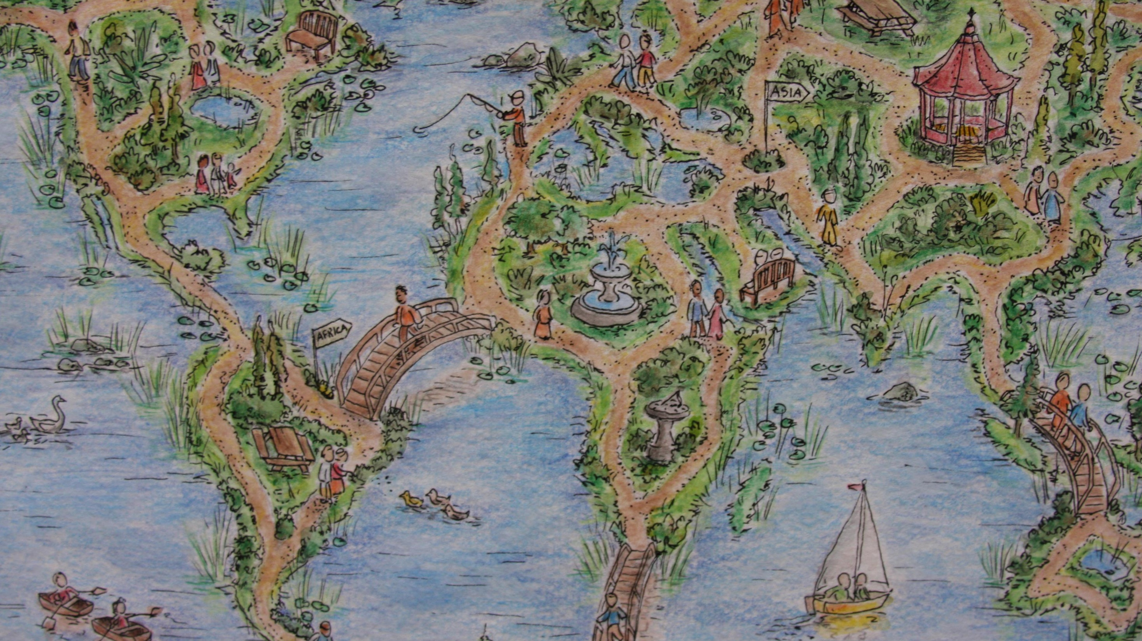
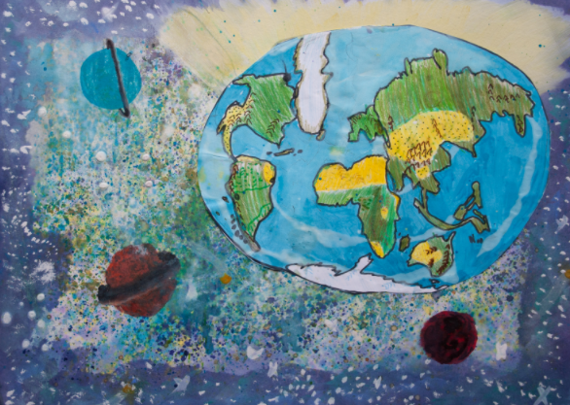
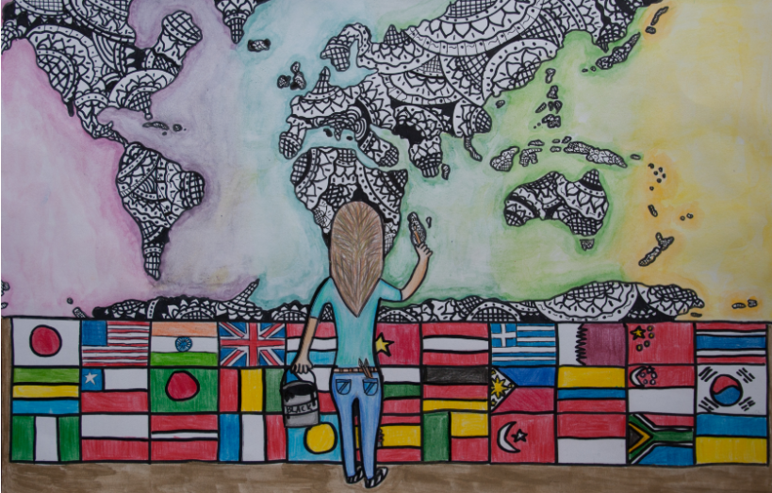
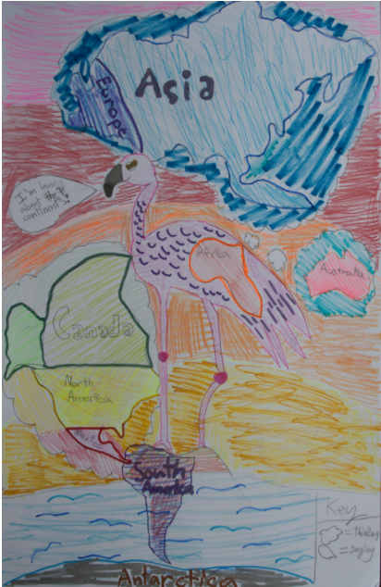
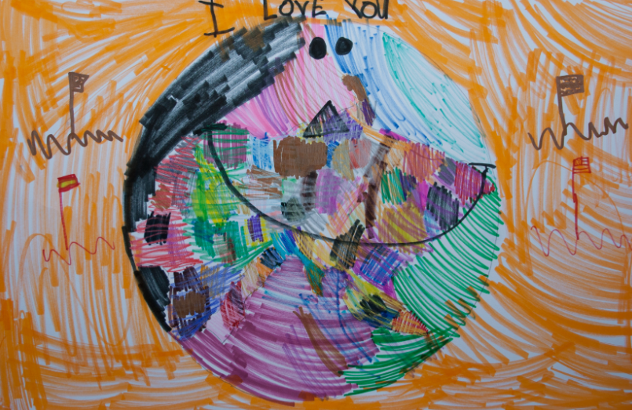
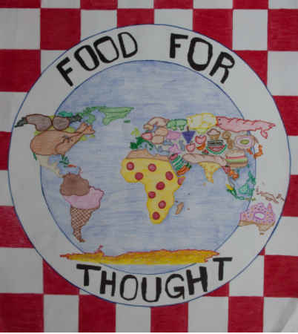
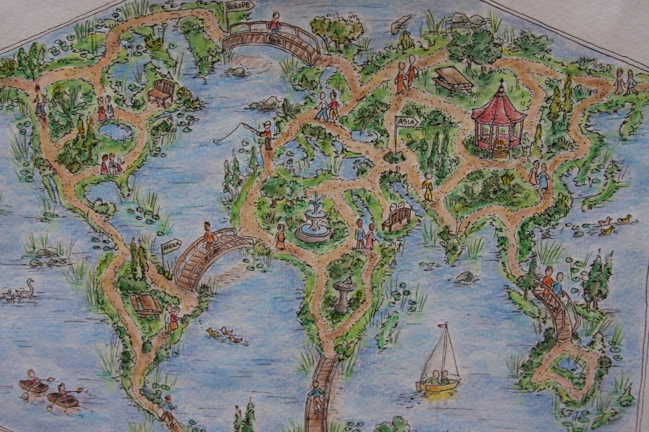
Images From 2017
Theme: We Love Maps
Notes:
U.S. Finalists, 2017
Top Left: Cheyanne Ligutan (Age 12), Painting the World a New Picture.
Top Right: Amy Marie Doval Valdes Rodriguez (Age 10), Earth – a Fascinating Place Deep, Deep Inside the Milky Way.
Middle Left: Shivani Patel (Age 13), We Love Maps: Food For Thought.
Middle Center: Ewa Bodzianowski & Kaia Vazquez (Age 8), A Bird’s Eye View.
Middle Right: Molly Rascon (Age 5), Colorful Earth Puzzle.
Bottom: Champ Turner (Age 15), Winner of Public vote, Maps: Our Path for Exploration.

Slide 9
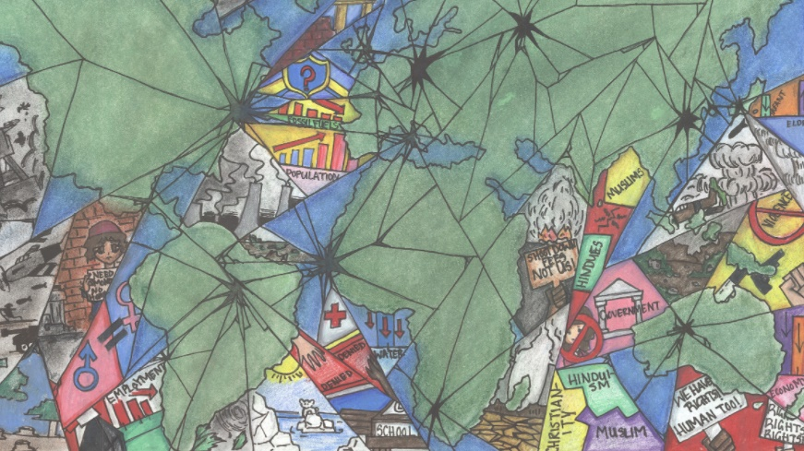
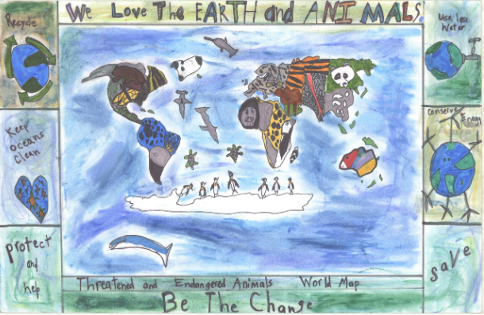
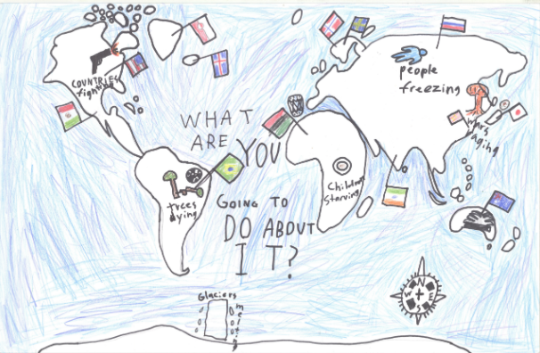
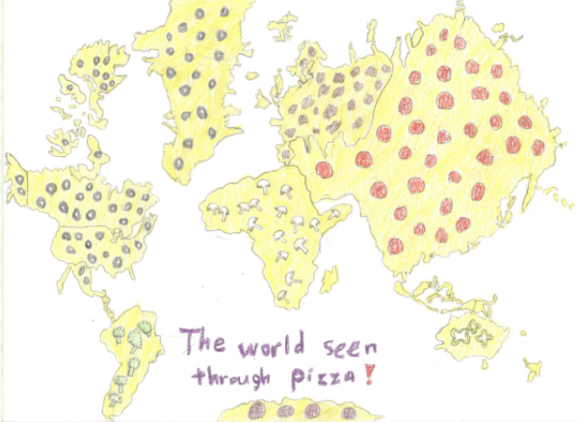
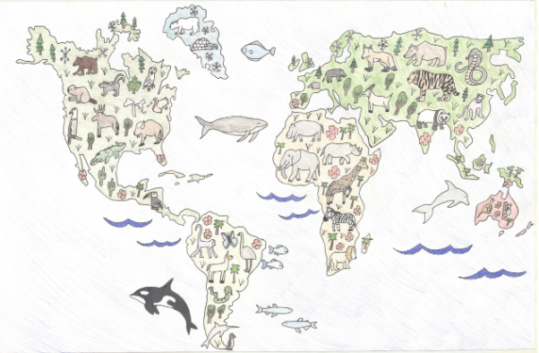
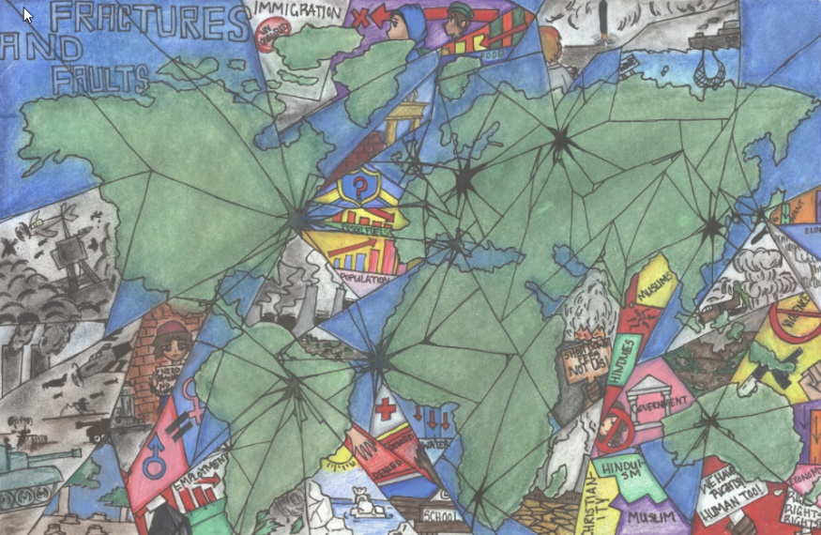
Images From 2019
Theme: We Love Maps
Notes:
U.S. Finalists, 2019:
Top Left: Laken Beste (Age 9), We Love Our World and its Animals: Save and Protect them.
Top Middle: Lukas Hanson (Age 12), What Are We Going to Do About It?
Top Right: Elliott Phillips (Age 8), The World Seen Through Pizza!
Middle Left: Anne Berg (Age 15), If We Don’t Change.
Middle Right: Danielle M. Morales (Age 15), Animals of the World (Except Antarctica)
Bottom: Universal Moo (Age 14), Fractures and Faults.

Slide 10
Age Categories
Under 6 Years Old
6–8 Years Old
9–12 Years Old
13 through 15 Years Old
Children can work in a team with up to three others in the same age category to produce a single entry

Slide 11
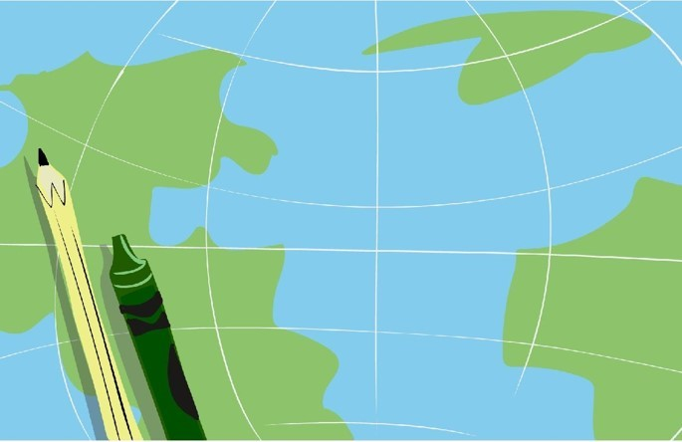
Rules
Illustrate the theme “A Map of My Future World” using pictures, drawings, words, objects, or other graphical elements
Include a map of all or large portion of the world with recognizable continents, age-appropriate features, and/or representations
Submit original hard copy map—no digital files will be accepted
Scan or photograph the finished illustration Submitted entries will not be returned
Maximum size is 11 x 17 inches
Please use a tracking number for entries!

Slide 12
Judging
Portray a recognizable message
Display cartographic content (symbols, colors, names, etc.)*
Strive for overall quality (balance, harmony, use of color, legibility)
Use a “system of projections” to depict coastlines, land masses, or boundaries
Enter an original work
Use traditional methods (i.e., color pencils, crayons, watercolor, 3D objects) or a computer program
Use nonperishable and unbreakable materials (no glass, leaves of plants, etc.)
Note: Cartographic accuracy is not a primary concern, though the illustration should be recognizable as a map in combination with the artist’s unique interpretation of the theme or story

Slide 13
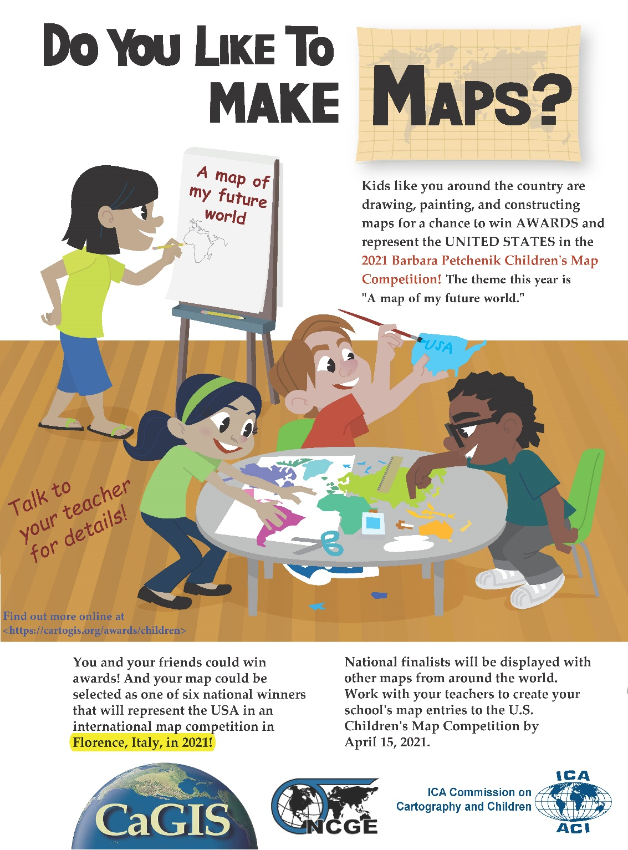
Promote The Competition
Link from https://cartogis.org/awards/children/rules/

Slide 14
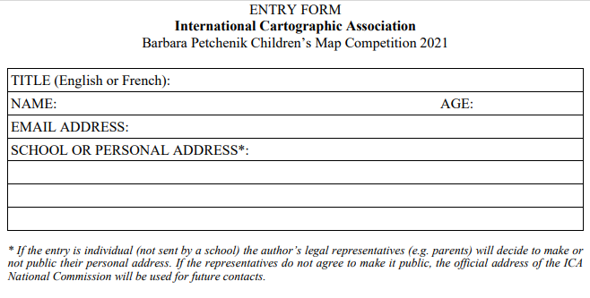
Entry Form
Link from https://cartogis.org/awards/children/rules/

Slide 15
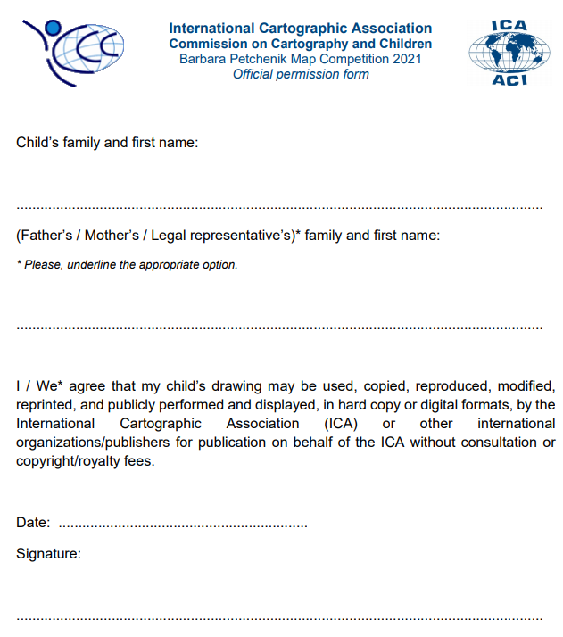
PermissionSlip
Link from https://cartogis.org/awards/children/rules/

Slide 16
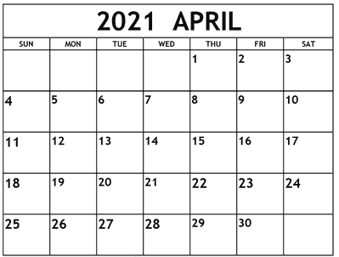
Deadline: Send Entries So They Arrive By April 15

Slide 17
More Information
U.S. Children’s Map Competition
CaGIS: https://cartogis.org/awards/children/
NCGE: https://ncge.org/programs/childrens-map-competition/
Petchenik Children’s Map Competition
https://icaci.org/petchenik/
Petchenik Children’s Map Competition Archives
ICA: https://icaci.org/petchenik
Carlton University Library: https://childrensmaps.library.Carleton.ca

Slide 18
Contact Information
Dierdre Bevington-Attardi
U.S. Children’s Map Competition
P.O. Box 4339
Silver Spring, MD 20914
dbevington.attardi@gmail.com

